Slide 1
SECURE HASH ALGORITHM

Slide 2
MD5
A msg digest algorithm designed by Ronald Rivest (the R in RSA)
Latest in a series of MD2, MD4
Is quite fast and produces 128-bit message digests
until recently was the most widely used hash algorithm
  in recent times have both brute-force & cryptanalytic concerns
specified as Internet standard RFC1321
Notes:
MD5 is the current, and very widely used, member of Rivest’s family of hash functions.

Slide 3
MD5 Overview
Input- processed in 512-bit blocks(which are further divided into 16 32-bit sub-blocks).
Output-is a set of four 32-bit blocks, which make up the 128-bit message digest.

Slide 4
MD5 WORKS
STEPS
Padding
Append Length
Divide the input into 512-bit blocks
Initialize MD buffer.
Process blocks

Slide 5
Step 1:Padding
Aim-To make the length of the original msg equal to a value which is 64 bits less than an exact multiple of 512.
(length=448 mod 512).
Eg:-length of the original msg-1000 bits
Padding-472 bits
Length of the msg-1472(1472+64=1536)

Slide 6
Padding consists of a single 1-bit ,followed by as many 0-bits,as required.
Padding is always added , even if the msg length is already 64 bits less than a multiple of 512.
Eg:-msg. length, 448+512=960 bits.
Padding length is any value between 1 and 512.

Slide 7
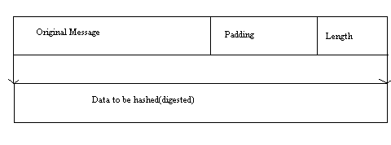
Step 2:Append Length
The length of the msg. is calculated, excluding the padding bits.
Append the 64-bit length value to message.
If the original length is greater than 2⁶⁴, then only the low- order 64 bits of the length are used.

Slide 8

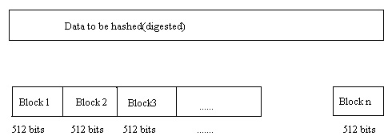
Step 3:Divide the input into 512-bit blocks

Slide 9
Step 4: Initialize MD buffer.
A 128-bit buffer is used to hold intermediate and final results of the hash function.
The buffer can be represented as four 32-bit registers (A, B, C, D). These registers are initialized to the following 32-bit integers (hexadecimal values):
A = 67 45 23 01
B = EF CD AB 89
C = 98 BA DC FE
D = 10 32 54 76

Slide 10
Step 5:Process Blocks
process message in 16-word (512-bit) blocks:
  Compression function that consists of 4 rounds of processing labelled as HMD5.
  Each round takes as i/p the current 512 bit block being processed(Yq) and 128 bit buffer value ABCD and updates the content of the buffer.
  Output of the fourth round is added to the i/p to the first round(CVq) to produce CVq+1
Notes:
The padded message is broken into 512-bit blocks, processed along with the buffer value using 4 rounds, and the result added to the input buffer to make the new buffer value. Repeat till run out of message, and use final buffer value as hash. nb. due to padding always have a full final block (with length in it).

Slide 11
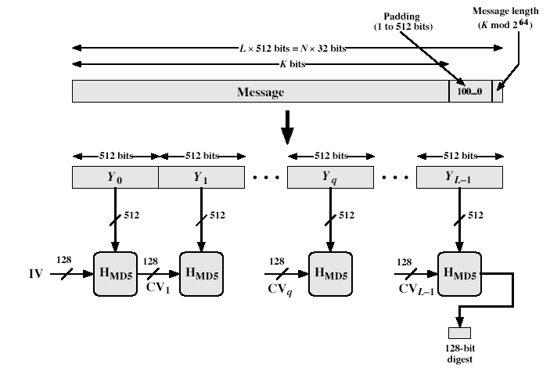
MD5 Overview
Notes:
Stallings Fig 12.1

Slide 12
Output: After all L 512bit blocks have been processed ,the output from the Lth stage is the 128bit msg digest

Slide 13
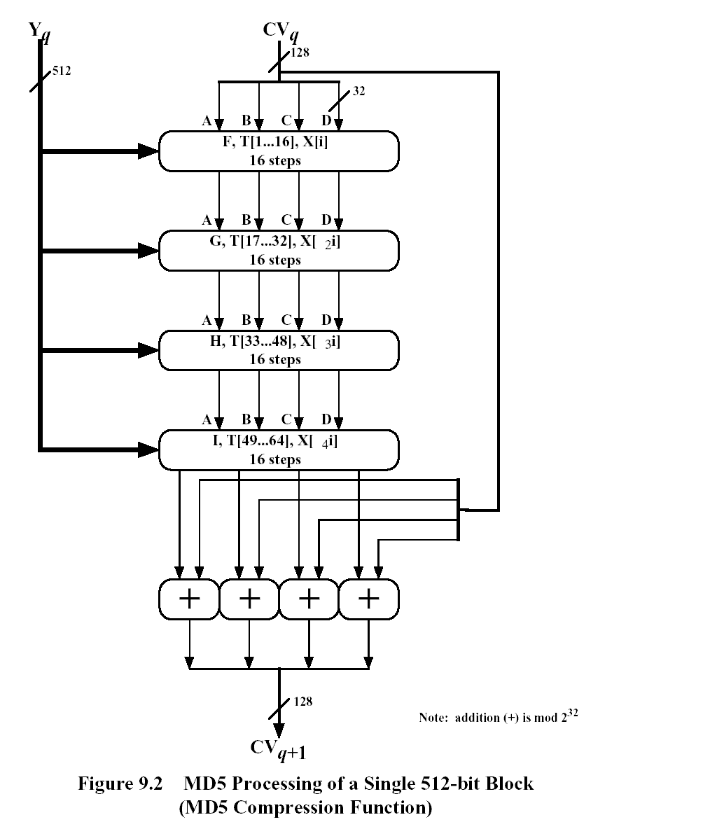

Slide 14
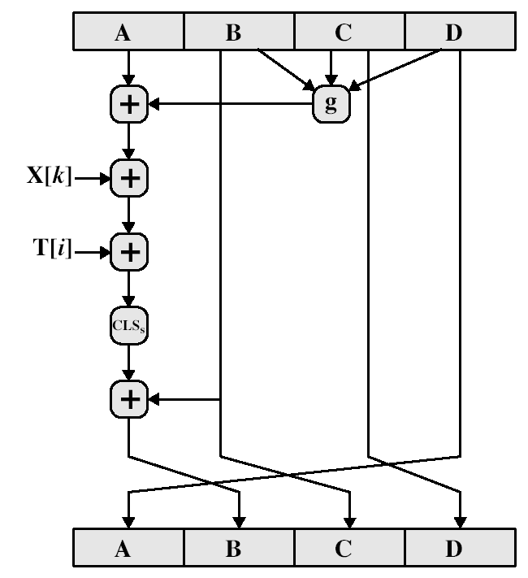
MD5 Compression Function

Slide 15
MD5 Compression Function
each round has 16 steps of the form:
  a = b+((a+g(b,c,d)+X[k]+T[i])<<<s)
  a,b,c,d-four words of the buffer, in a specified order that varies across steps
  g-one of the primitive functions F,G,H ,I
  <<<s-Circular shift of 32bit argument by s-bits
  T[i]-ith 32 bit word in matrix T
  +-addition modulo 2³²
Notes:
Each round mixes the buffer input with the next "word" of the message in a complex, non-linear manner. A different non-linear function is used in each of the 4 rounds (but the same function for all 16 steps in a round). The 4 buffer words (a,b,c,d) are rotated from step to step so all are used and updated. g is one of the primitive functions F,G,H,I for the 4 rounds respectively. X[k] is the kth 32-bit word in the current message block. T[i] is the ith entry in the matrix of constants T. The addition of varying constants T and the use of different shifts helps ensure it is extremely difficult to compute collisions.

Slide 16
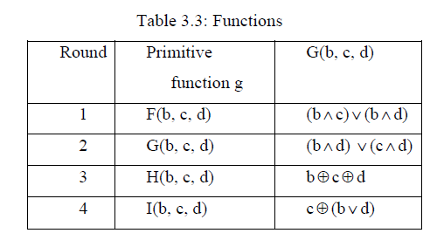

Slide 17
MD4
precursor to MD5
also produces a 128-bit hash of message
has 3 rounds of 16 steps vs 4 in MD5
Design goals:
Security:It be computationally infeasible to find two msg’s that have the same msg digest.
Speed:Algm is intended to be fast on 32 bit architecture.
Simplicity and Compactness : Algm should be simple to describe and simple to pgm
Notes:
MD4 is the precursor to MD5, and was widely used. It uses 3 instead of 4 rounds, and the round functions are a little simpler. In creating MD5 Rivest aimed to strengthen the algorithms by introducing the extra round, and varying the constants used.

Slide 18
Difference between MD4 and MD5
1.MD4 uses 3 rounds of 16 steps each,MD5 uses 4 rounds of 16 steps each
2.MD4,no additive constant used in first round.
second round-same additive constant is used for each step
third step-Another additive constant is used for each step
In MD5 different additive constant T[i],is used for each of the 64 steps

Slide 19
3.MD5 uses primitive logical functions, one for each round, compared to 3 for each MD4,again one for each round.
4.MD5 each step adds in the result of the preceding step.MD4 did not include this.

Slide 20
Strength of MD5
Every bit of the hash code is a function of every bit in the i/p
Rivest claims security is good
Known attacks are:
  Berson - using differential cryptanalysis, possible in reasonable time to find two msg’s that produce the same digest for single round. But he was not able to generalize attack to full round
Notes:
Some progress has been made analysing MD5, which along with the hash size of 128-bits means its starting to look too small. Hence interest in hash functions that create larger hashes.

Slide 21
  Boer & Bosselaers - showed execution of MD5 on a single block of 512bits yeild the same output for two different input values in buffer ABCD->pseudocollision.But he was not able to extend this approach to a successful attack on MD5
  Dobbertin - operation of MD5 on a single 512bit block of i/p by finding another block that produces the same 128bit.He was not able to generalize it
Conclusion is that MD5 looks vulnerable soon

Slide 22
Secure Hash Algorithm (SHA-1)
SHA was designed by NIST in 1993, revised in 1995 as SHA-1
produces 160-bit hash values
now the generally preferred hash algorithm
based on design of MD4 with key differences
Notes:
SHA is one of the newer generation of hash functions, more resistant to cryptanalysis, and now probably preferred for new applications.

Slide 23
SHA Overview
pad message so its length is 448 mod 512
append a 64-bit length value to message
initialise 5-word (160-bit) buffer (A,B,C,D,E) to
  (67452301,efcdab89,98badcfe,10325476,c3d2e1f0)
process message in 16-word (512-bit) chunks:
  Consists of four rounds of processing of 20 steps each.
  Four rounds uses different primitive logical func,f1,f2,f3,f4
  Each round takes as i/p the current 512bit block being processed(Yq) and 160bit buffer value A,B,C,D,E and updates buffer
Notes:
Note that the SHA-1 Overview is very similar to that of MD5.

Slide 24
Each round uses an additive constant K_{t} where 0<=t<=79,indicates one of the 80 steps across five rounds
Output of the 4th round is added to the i/p of the first round(CVq) to produce CV_{q+1}
Output: After L 512 bit blocks have been processed, the output from Lth stage is 160bit msg digest

Slide 25
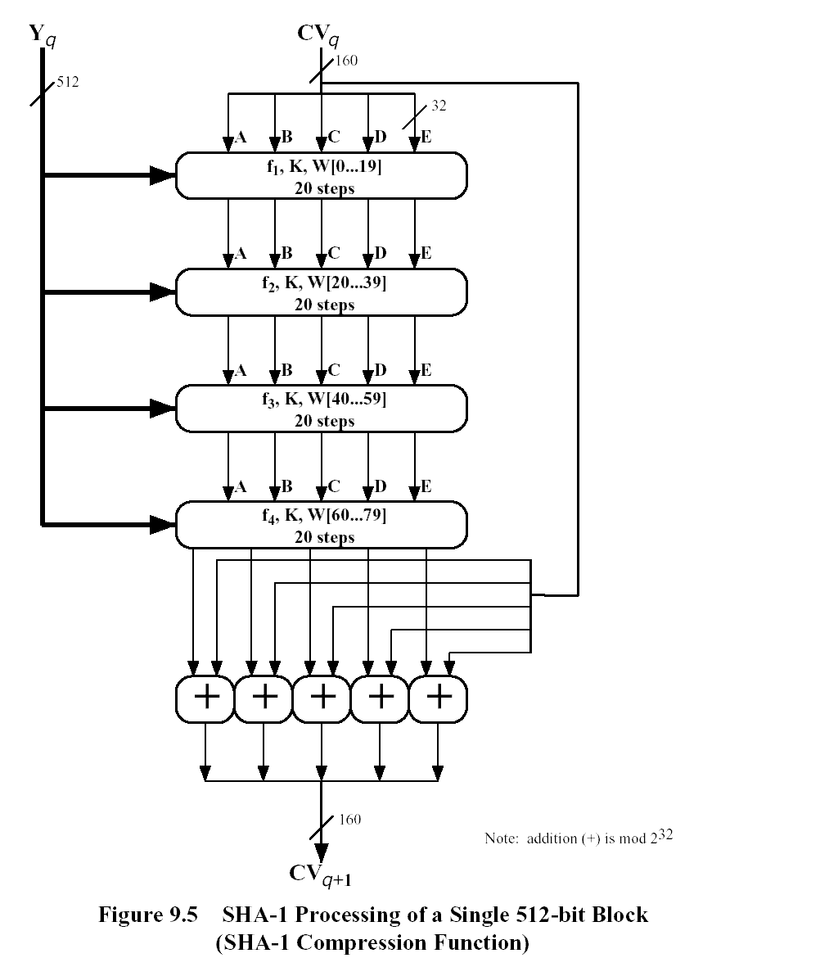

Slide 26
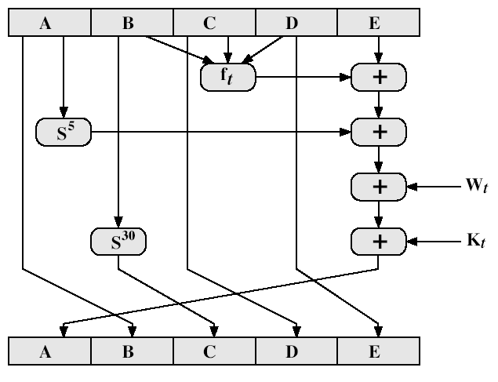
SHA-1 Compression Function

Slide 27
SHA-1 Compression Function
Each round has 20 steps which replaces the 5 buffer words thus:
  (A,B,C,D,E) <-(E+f(t,B,C,D)+(A<<5)+W_{t}+K_{t}),A,(B<<30),C,D)
t is the step number
f(t,B,C,D) is nonlinear function for round
W_{t} is derived from the message block
K_{t} is a constant value
Notes:
Can see SHA shares much in common with MD4/5, but with 20 instead of 16 steps in each of the 4 rounds. Note the 4 constants are based on sqrt(2,3,5,10). Note also that instead of just splitting the input block into 32-bit words and using them directly, SHA-1 shuffles and mixes them using rotates & XOR’s to form a more complex input, and greatly increases the difficulty of finding collisions.

Slide 28
SHA-1 verses MD5
brute force attack is harder (160 vs 128 bits for MD5)
not vulnerable to any known attacks (compared to MD4/5)
a little slower than MD5 (80 vs 64 steps)
both designed as simple and compact
optimised for big endian CPU's (vs MD5 which is optimised for little endian CPU’s)
Notes:
Compare using the design goals listed earlier.
SHA-1 is probbaly the preferred hash function for new applications. Currently no problems are known with it.

Slide 29
SHA 512 Logic
Takes as input a msg with max length of less than 2¹²⁸bits
Produce as output a 512 bit msg digest
i/p is processed in 1024 bit blocks

Slide 30
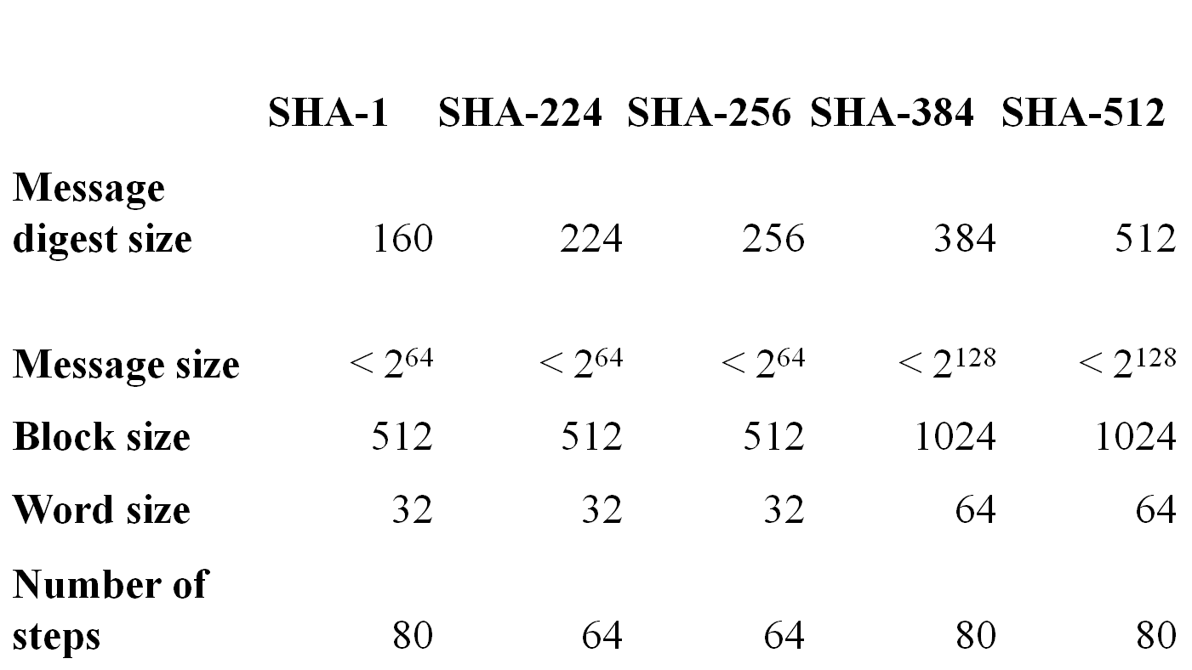
SHA Versions
Notes:
Stallings Table 11.3 provides a comparison of the various parameters for the SHA hash functions.

Slide 31
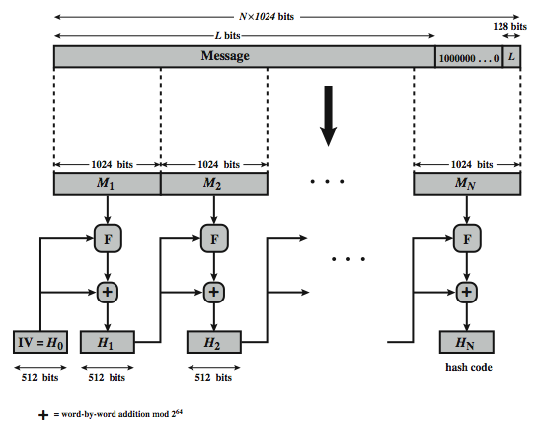

Slide 32
SHA 512 Overview
pad message so its length is 896modulo 1024
append a 128-bit length value to message
Initialize hash buffer
512 bit buffer used to hold intermediate and final results of hash fun(a,b,c,d,e,f,g,h),values are stored in big endian format
4. process message in 1024 bit(128 word) blocks:
  Algorithm consists of 80 rounds
Notes:
The padded message is broken into 512-bit blocks, processed along with the buffer value using 4 rounds, and the result added to the input buffer to make the new buffer value. Repeat till run out of message, and use final buffer value as hash. nb. due to padding always have a full final block (with length in it).

Slide 33
  Each round takes as input 512bit buffer value and updates the content of the buffer
  Each round uses an additive constant K_{t},0<=t<=79 ,indicates one of the 80 rounds
  Output of the 80th round is added to the input to the first round to produce H_{i}
  5. After all N 1024 bit blocks have been processed ,the output from the Nth stage is the 512 bit digest.

Slide 34
  H₀=IV
  H_{i}=SUM₆₄(H_{i-1,}abcdefgh_{i})
  MD=H_{N}
where,
IV=initial value of the abcdefgh buffer,defined in step3
abcdefgh_{i}=the o/p of the last round of processing of the ith message block.
N=the no: of blocks in the msg
SUM₆₄=addition modulo 2⁶⁴ performed separately on each word of the pair of inputs
MD=final message digest value

Slide 35
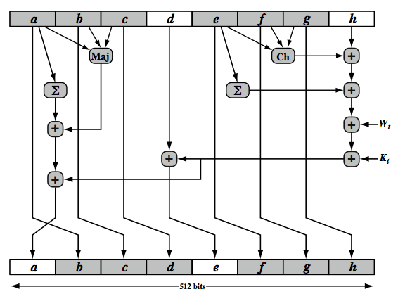
SHA-512 Round Function

Slide 36
SHA-512 Round Function
Each round is defined by the following set of equations:
T₁=h + Ch (e,f,g) +(∑₁⁵¹² e)+Wt + Kt
T2=(∑₀⁵¹² a)+Maj (a,b,c)
a=T1+T2
b=a
c=b
d=c
e=d+T1
f=e
g=f
h=g

Slide 37
where,
t= step number;0≤t≤79
Ch(e,f,g)=(e AND f)XOR(NOT e AND g)
Maj(a,b,c)=(a AND b)XOR(a AND c)XOR(b AND c)
(∑₀⁵¹² a)=ROTR²⁸(a) XOR ROTR³⁴(a) XOR ROTR³⁹ (a)
(∑₁⁵¹² e)=ROTR¹⁴(e) XOR ROTR¹⁸⁽e) XOR ROTR⁴¹ (e)
ROTR ^{n}(x)=circular right shift(rotation) of the 64-bit argument x by n bits
W_{t}=a 64-bit word derived from the current 512-bit input block
K_{t}= a 64-bit additive constant
+=addition modulo 264

